Slide 1

HR Analytics Dashboard
A Data-Driven Approach to Understanding Workforce & Attrition
Regards,
Arun M

Slide 2
Problem Statement:
  ⚠️ Organizations struggle to understand the root causes of attrition.
  🔍 HR teams require deeper insights into workforce trends.
  🕒Decisions often lack real-time and department-level visibility.

Slide 3
  Objective of Analysis:
  🎯Identify key drivers of employee attrition
  👥Analyze workforce demographics and distribution
  📊 Assess promotion delays and employee risk levels
  💡Provide actionable insights for HR decision-making

Slide 4
Tools Used
Power BI – Dashboard Creation
Excel / CSV – Data Source
DAX – KPI Calculations
Power Query – Data Cleaning & Transformation

Slide 5
Dataset Overview
  Total Records: 1470
  Columns: 30+ HR variables
  Key Fields:
    Age, Gender
    Department, Job Role
    Education Field
    Experience
    Promotion Risk
    Attrition (Yes/No)

Slide 6
Key Metrics (KPIs)
👥 Total Employees: 1470
🎯 Active Employees: 1233
📉 Attrition: 237 (16.1%)
🔥 High-Risk Attrition: 39%
💰 Avg Attrition Salary: 4.79K

Slide 7
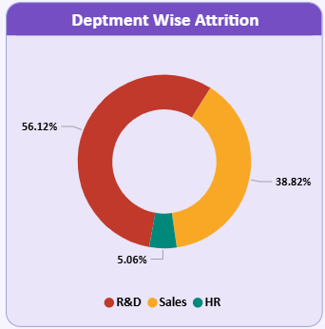
Attrition Analysis
R&D has the highest attrition (56.12%)
Sales follows with 38.82%
HR shows minimal attrition
Younger workforce (25–34) leaves the most
Education field "Life Sciences" has highest attrition

Slide 8
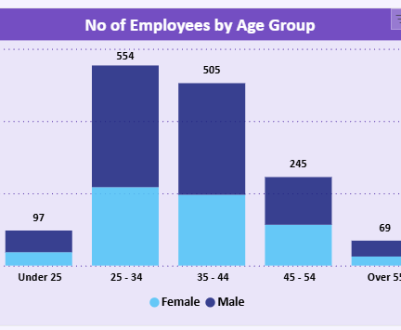
Workforce Demographics
Majority workforce in 25–34 & 35–44 age groups
Gender distribution is male-dominated
Workforce is well spread across departments

Slide 9
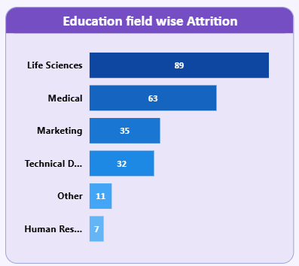
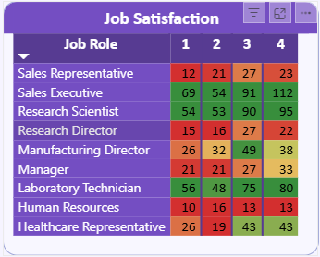
Education & Job Role Insights
Life Sciences → highest attrition (89)
Medical → 63
Sales roles show lower satisfaction
Research roles show higher satisfaction

Slide 10
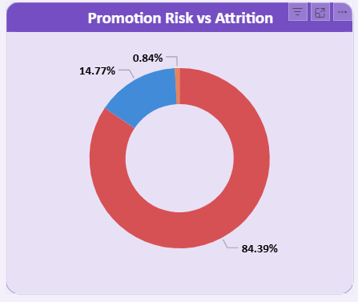
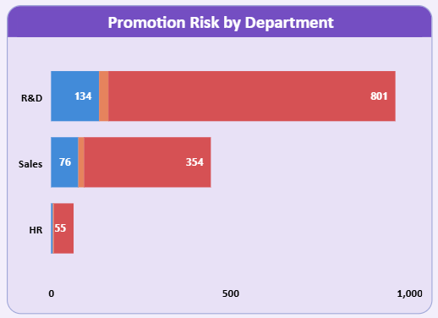
Promotion Risk Analysis
215 employees are in high promotion risk
Strong correlation between promotion delays & attrition
R&D has the highest number of promotion delays
84.39% of high-risk employees eventually leave

Slide 11
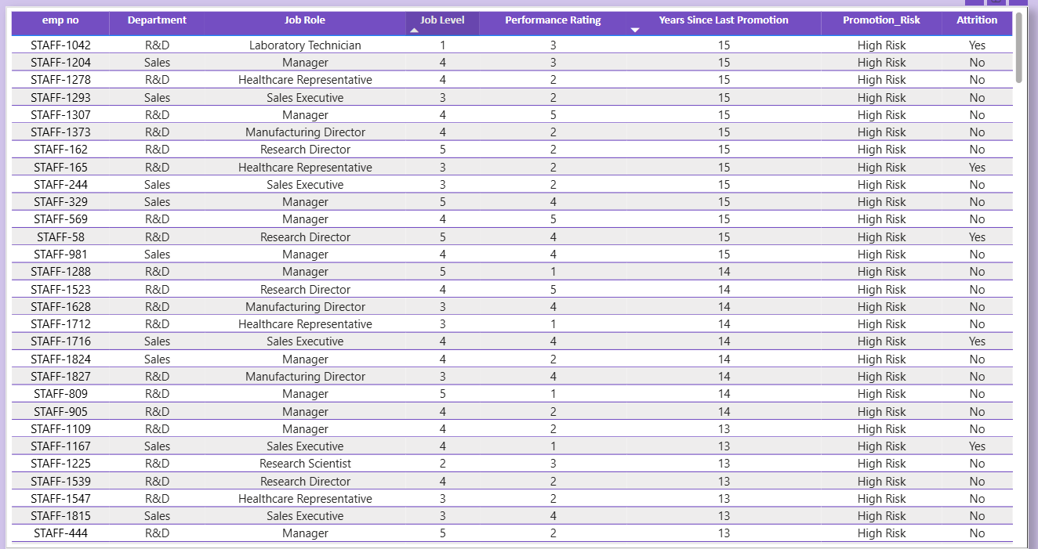
High-Risk Employee Insights
Employees with 13–15 years no promotion highest risk
R&D dominates high-risk list
Critical affected roles:
  Lab Technician
  Sales Executive
  Healthcare Rep
  Manufacturing Director

Slide 12
Recommendations & Conclusion
Improve promotion cycle transparency
Focus on career development programs
Revisit workload distribution in R&D
Retention plans for mid-experience employees
Salary benchmarking for competitive roles
Conclusion:
This HR Analytics Dashboard provides actionable insights for reducing attrition and improving employee satisfaction.

